Slide 1
Avanade Data Analytics Kick off Initiatives FY21
Mauritius ATC
15 March 2021

Slide 2
Agenda
Overview of Avanade Data Analytics Practice
Purpose for Initiatives
Initiatives FY21
Certifications
Feedback/Suggestions

Slide 3














Overview of Avanade Data Analytics Practice
25
Technologies
# of resources
Active Projects
Projects in pipe
2
11
3
2
16
2
1
Wave 2
4
1

Slide 4
Purpose for Initiatives
Rapid Team Growth
Structure
Shared Responsibilities
Improve Communication
Knowledge Sharing
Skills Enhancement (Training & Certifications)
Establish Data Analytics Community

Slide 5


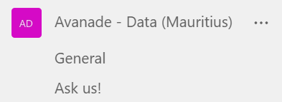
Initiatives FY21 - Teams
1. Creation of Avanade Data Team Email group
Accenture.Mauritius.Avanade.DataAnalytics@accenture.com
2. Teams for Avanade Data Analytics Team
Avanade - Data (Mauritius).
Ask Us!

Slide 6
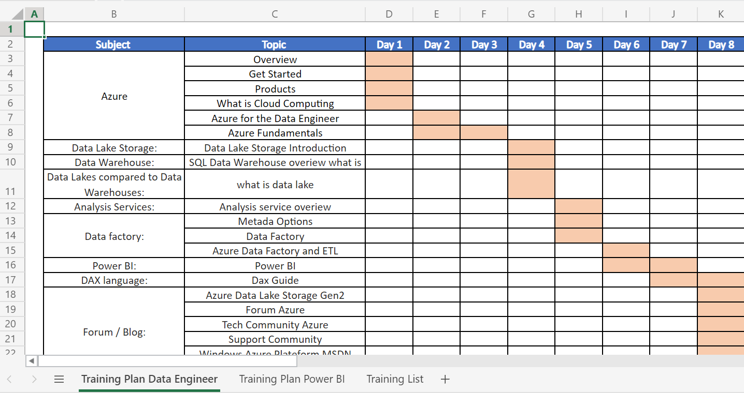
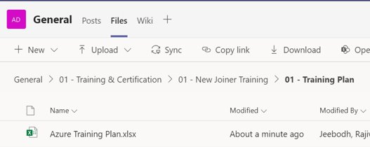
Initiatives FY21 – Training Plan
3. Training Plan for New Joiners
Training plan for 2 Streams:
Power BI
Data Engineer

Slide 7
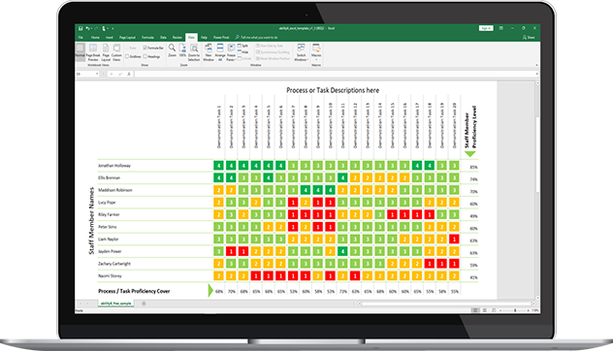
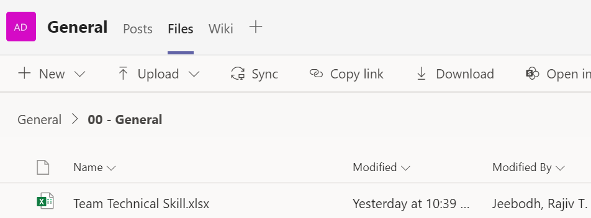
Initiatives FY21 – Skill Matrix
4. Team Skill Matrix
Regular updates of Skills
Enable team members to search for Subject Matter Expert.
Facilitate resources allocation within projects.
Track progress and areas of improvements.

Slide 8


Initiatives FY21 – Training & TC
5. Training and 1 Hour Tech calls
Regular Tech calls to share knowledge and project experiences
Organise Intra Training to share competence with team members
Open to Everyone!

Slide 9


Initiatives FY21 – Additional Materials
6. Additional Materials:
Standards, Best Practices & Innovation
Research on Standards and Best Practices per Technology.
Research on Innovation and automation

Slide 10



Initiatives FY21 – Ask Us!
7. Ask us!
Ask Us! Channel has been created as a Q&A Platform
The Benefits of this platform are:
Demonstration of Team Support
Establishment of Community & Engagement
Initiation of a Productive Knowledge Base
Identifies Subject ­Matter Expert

Slide 11

Initiatives FY21 – Knowledge Base
8. Knowledge Base
Repository to create a self-service library of information within Ask Us! Channel
Create and share insights about:
Practice
Technology
Process
Improvement
Tips & Tutorials
Troubleshooting

Slide 12





Certifications
Certifications
Ramp up on Azure Certifications and increase your expertise as from Now.
Getting Certified will be beneficial to you foremost and to the Avanade Data Analytics Team
Certifications Initiatives FY21:
AZ 900 to be completed end of April 2021
DP 900 to be completed end of May 2021
DP 200/201 or DP 203 to be completed end of June 2021
AZ 303 and AZ 304 to be completed end of August 2021
Follow-up will be done to help achieve the objectives

Slide 13


Feedback & Suggestions

Slide 14
Thank You

